Slide 1


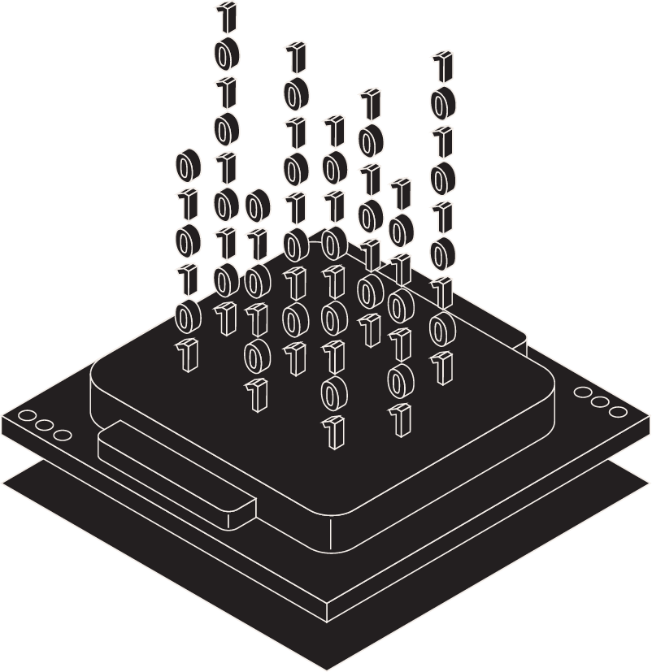
Computer Vision Project
License plate recognition in real time.
-Arnav Chaudhary (2K21/CO/97)

Slide 2
Table of contents
01
04
02
03
Introduction
Implementation
Uses Of LPR
Approach

Slide 3
Introduction
A license plate recognition (LPR) system, also known as automatic number plate recognition (ANPR), is a technology that uses cameras to automatically read and identify vehicle license plates. It works like this:
Image Capture
Optical Character Recognition (0CR)
A camera (usually mounted on the side of the road or on a police car) captures an image of a passing vehicle.
The software uses OCR to extract the alphanumeric characters from the license plate image.
Image Processing
Data Compression
Software analyzes the image to locate the license plate.
The LPR system compares the license plate number against a database of registered vehicles or other relevant databases.

Slide 4
Uses Of LPR
Law Enforcement
Traffic Managemen
Finding stolen vehicles: Police can compare LPR data with databases of stolen vehicles to quickly identify and apprehend criminals.
Investigating crimes: LPR systems can track the movements of vehicles involved in criminal activity, providing valuable evidence for investigations.
Enforcing traffic laws: LPR can be used to automatically identify vehicles that are speeding, running red lights, or parked illegally.
Toll collection: LPR can be used to automate toll collection on highways and bridges.
Congestion pricing: LPR can be used to enforce congestion pricing schemes, where drivers are charged a fee to enter busy areas during peak hours.
Traffic monitoring: LPR data can be used to track traffic flow and identify bottlenecks.

Slide 5
Approach
Find all the contours in the image.
Apply image segmentation in the image inside the validated contour to find characters in it.
Find the bounding rectangle of every contour.
Recognize characters using an OCR.
Compare and validate the sides ratio and area of every bounding rectangle with an average license plate.
01
02
03
04
05

Slide 6
01
Implementation

Slide 7
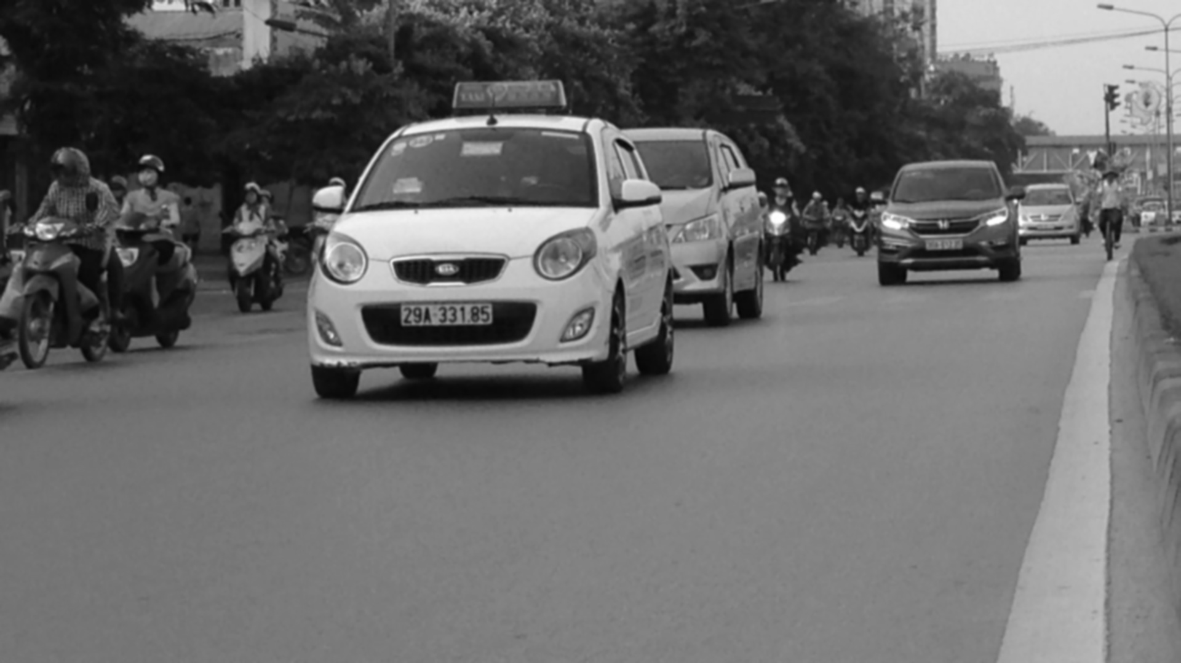
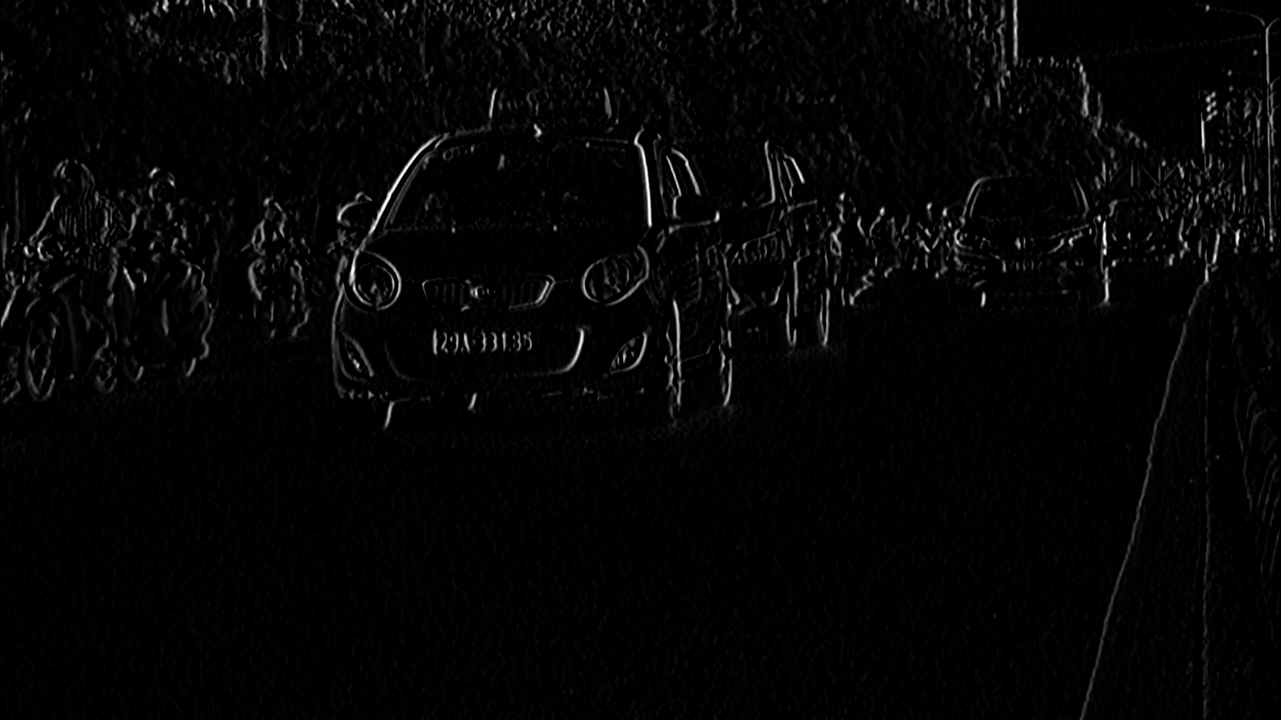
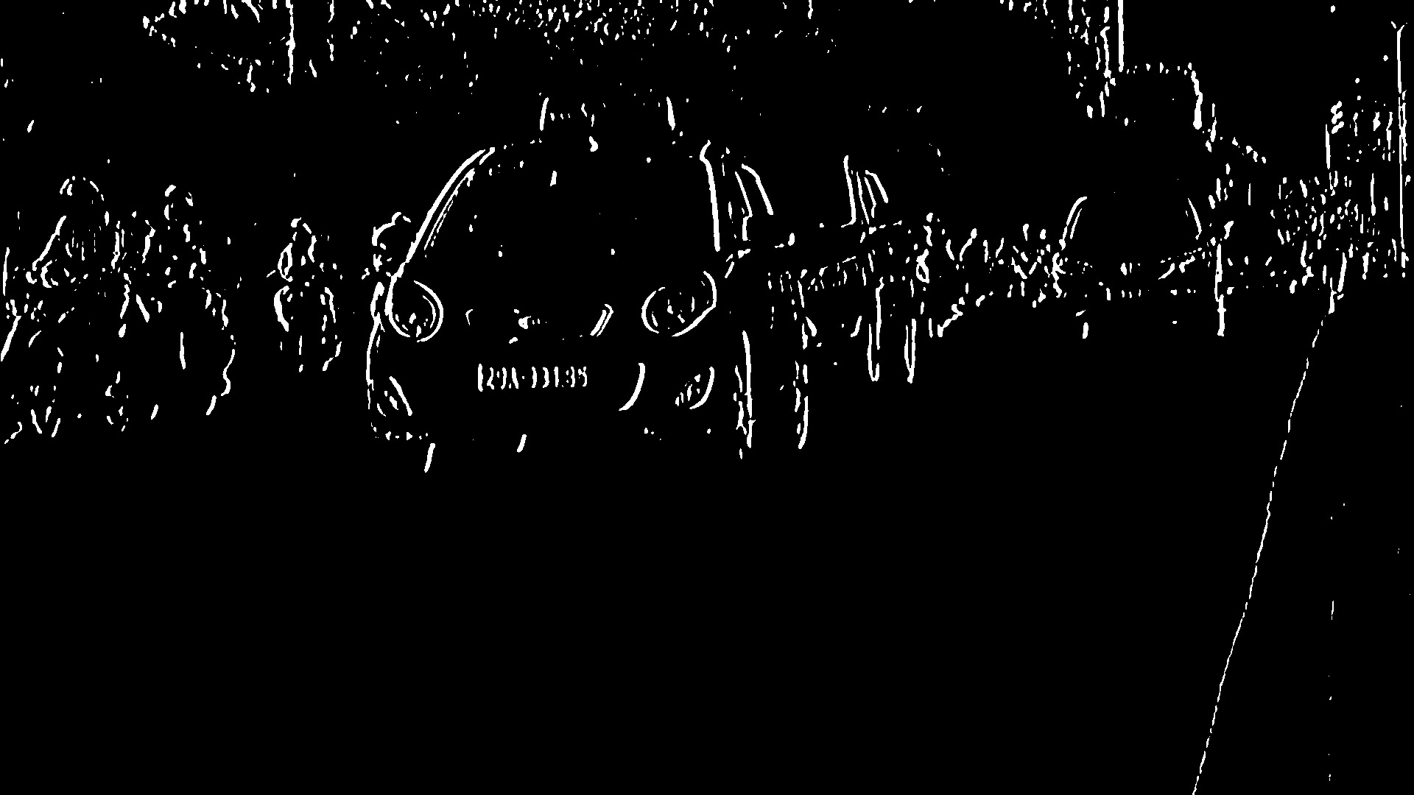
Step - 1
Step - 2
Step - 3
To reduce the noise we need to blur the input Image with Gaussian Blur and then convert it to grayscale.
Find vertical edges in the image.
To reveal the plate we have to binarize the image. For this apply Otsu’s Thresholding on the vertical edge image. In other thresholding methods, we have to choose a threshold value to binarize the image but Otsu’s Thresholding determines the value automatically.

Slide 8
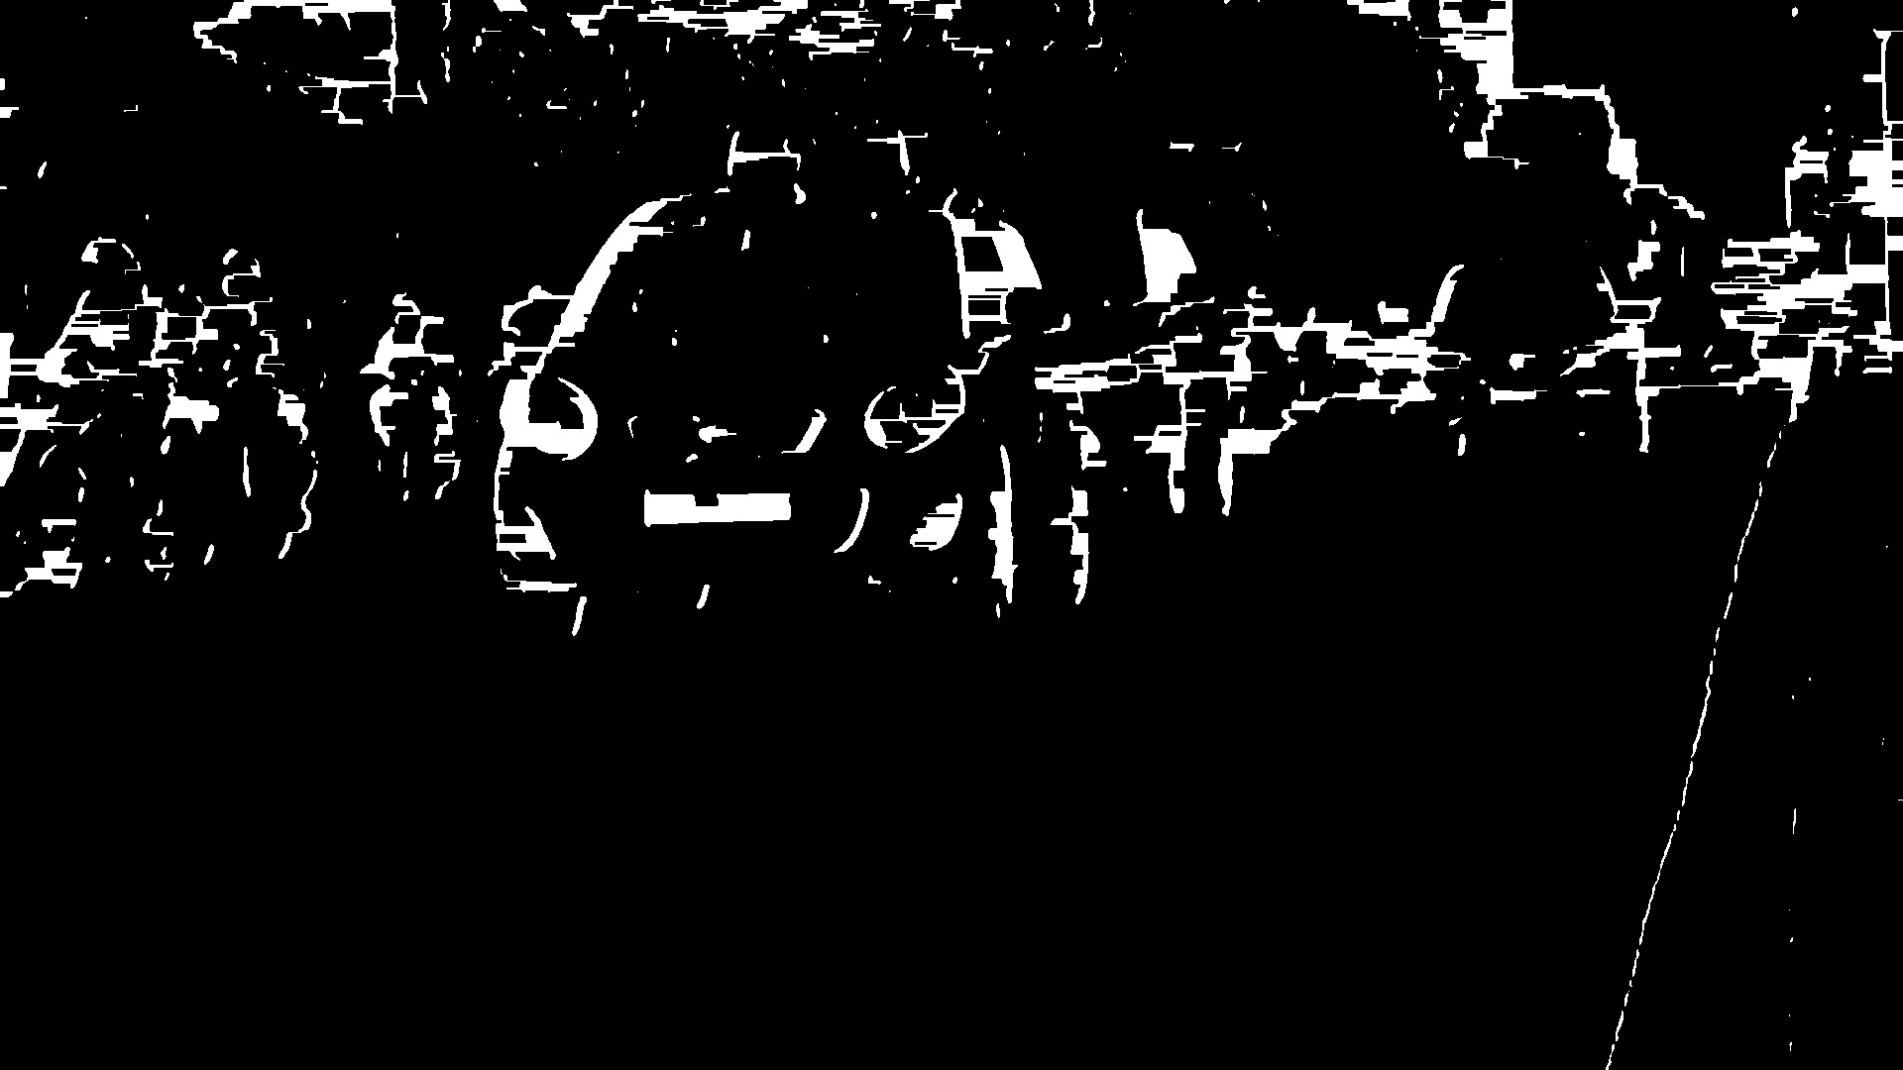
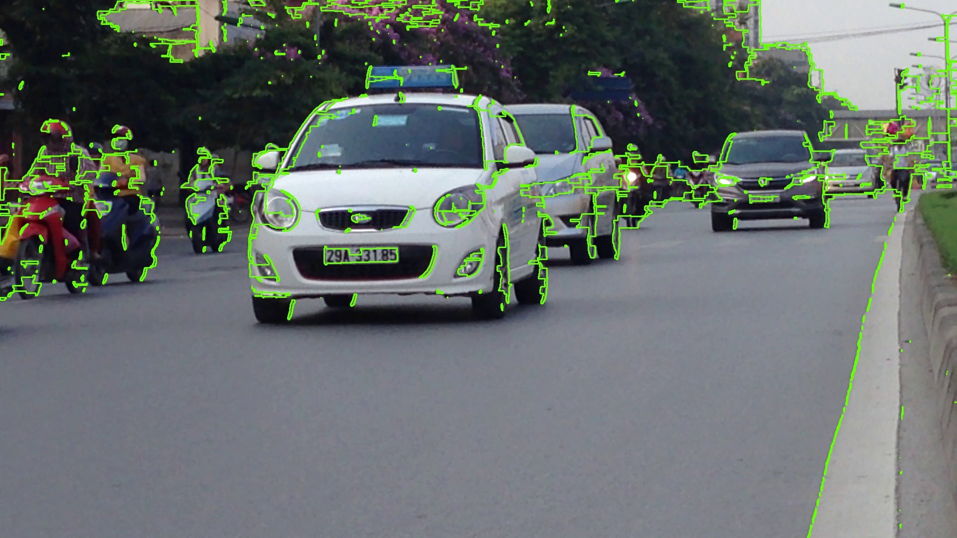
Step - 4
Step - 5
Apply Closing Morphological Transformation on the thresholded image. Closing is useful to fill small black regions between white regions in a thresholded image. It reveals the rectangular white box of license plates.
To detect the plate we need to find contours in the image. It is important to binarize and morph the image before finding contours so that it can find a more relevant and less number of contours in the image. If you draw all the extracted contours on the original image, it would look like this:

Slide 9

Step - 6
Step - 7
Now find the minimum area rectangle enclosed by each of the contours and validate their side ratios and area. We have defined the minimum and maximum area of the plate as 4500 and 30000 respectively.
Now find the contours in the validated region and validate the side ratios and area of the bounding rectangle of the largest contour in that region. After validating you will get a perfect contour of a license plate. Now extract that contour from the original image. You will get the image of the plate:

Slide 10
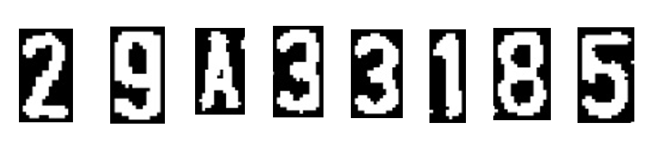
Step – 8: To recognize the characters on the license plate precisely, we have to apply image segmentation. The first step is to extract the value channel from the HSV format of the plate’s image.
Step – 9: Now apply adaptive thresholding on the plate’s value channel image to binarize it and reveal the characters. The image of the plate can have different lighting conditions in different areas, in that case, adaptive thresholding can be more suitable to binarize because it uses different threshold values for different regions based on the brightness of the pixels in the region around it.
Step – 10: After binarizing apply bitwise not operation on the image to find the connected components in the image so that we can extract character candidates.
Step – 11: Construct a mask to display all the character components and then find contours in the mask. After extracting the contours take the largest one, find its bounding rectangle and validate side ratios.
Step – 12: After validating the side ratios find the convex hull of the contour and draw it on the character candidate mask.
Step – 13: Now find all the contours in the character candidate mask and extract those contour areas from the plate’s value thresholded image, you will get all the characters separately.

Slide 11
Conclusion
License Plate Recognition (LPR) technology has emerged as a powerful tool for improving public safety, traffic flow, and security. LPR systems can assist law enforcement in investigations, deter crime, and recover stolen vehicles. They can also streamline traffic management by automating toll collection, congestion pricing, and parking access.
However, it's vital to acknowledge the privacy concerns surrounding LPR data collection and usage. As we move forward, it's important to strike a balance between leveraging the benefits of LPR and upholding individual privacy rights. Responsible implementation with clear guidelines will ensure LPR remains a valuable asset for our communities.

Slide 12
Thanks!

